Slide 1

RECAP
Last Session

Slide 2
RECAP
Last Session
A value chain is every step that turns inputs into something customers will pay for
Cost analysis finds where money is spent, and whether each step earns it back
Hero Cycles built a world-record business by controlling one link better than rivals

Slide 3

A Tale of Brothers

Slide 4

But why Anil Ambani failed but Kamath brothers thrived?

Slide 5
A STORY TO START
Zero Funding, India's Largest Stockbroker
2010, Bengaluru
A frustrated trader tired of expensive, clunky brokers, starts a startup with his brother— no venture capital, no big launch budget.
What they built instead
A simple, low-cost, technology-first trading platform built entirely in-house — something bigger, funded rivals struggled to copy quickly.
Today
His venture is one of India's largest stockbrokers by active clients, built entirely without outside investors — on the strength of one deep, hard-to-copy capability.

Slide 6
CORE CONCEPT 1
Competence?
Based on: A. Nag, Strategic Management: Analysis, Implementation and Control, Ch. 5.
6 / 16

Slide 7
CORE CONCEPT 1
What Is a Competence?
A competence is a skill or capability your organization has built up not a thing you own, like cash or equipment, but something you and your people know how to do well.
Resource vs. competence
A resource is a laptop. A competence is knowing how to build fast, reliable trading software with it. Zerodha's real edge was never the laptops — it was the capability.
Based on: A. Nag, Strategic Management: Analysis, Implementation and Control, Ch. 5.
6 / 16

Slide 8
TWO OF FOUR TYPES
Threshold vs. Core Competencies
Threshold
Core
Based on: A. Nag, Strategic Management: Analysis, Implementation and Control, Ch. 5.
7 / 16

Slide 9
TWO OF FOUR TYPES
Threshold vs. Core Competencies
Threshold
Core
The bare minimum every player in the category needs just to compete at all — like basic regulatory compliance for a broker.
Hard-to-imitate strengths leveraged across markets — like Zerodha's customer support operations.
Based on: A. Nag, Strategic Management: Analysis, Implementation and Control, Ch. 5.
7 / 16

Slide 10
THE OTHER TWO TYPES
Distinctive vs. Strategic Competencies
Distinctive
Strategic
Based on: A. Nag, Strategic Management: Analysis, Implementation and Control, Ch. 5.
8 / 16

Slide 11
THE OTHER TWO TYPES
Distinctive vs. Strategic Competencies
Distinctive
Strategic
Genuinely rare but not impossible for rivals to copy quickly — like Zerodha's in-house technology platform, built over years.
A distinctive competence that also directly drives what customers choose you for — the rarest, most valuable overlap of all.
Based on: A. Nag, Strategic Management: Analysis, Implementation and Control, Ch. 5.
8 / 16

Slide 12
PUTTING THEM TOGETHER
The Four Types, Side by Side
Type | What It Means | Rare?
Threshold | The minimum to compete at all | No
Core | Important, even if others have it too | Yes/No
Distinctive | Rare but not impossible for rivals to copy | Yes
Strategic | Rare AND drives customer choice and hard to copy | Yes
Based on: A. Nag, Strategic Management: Analysis, Implementation and Control, Ch. 5.
9 / 16

Slide 13
BACK TO ZERODHA
Which Competencies Mattered Most
Threshold
Regulatory licensing — required, but not a real advantage
Core
Customer support and operations — solid, but not unique
Strategic
In-house trading technology — rare, hard to copy, and exactly why customers chose Zerodha
History based on widely documented accounts of Zerodha's technology-led business model.
11 / 16

Slide 14
BACK TO BONSHO'S MOMOS
His Competencies
Threshold
Distinctive
Core
Strategic

Slide 15
BACK TO BONSHO'S MOMOS
His Competencies
Threshold
Commercial kitchen setup, food safety/FSSAI licenses, sourcing standard flour and vegetables, and standard steaming equipment.
Distinctive
Trendy branding, Instagram-friendly packaging, a highly visible prime location near a college, or a unique trending flavor (like "Peri-Peri Cheese Injection Momos").
Core
Unique and tasty recipe for the chili chutney (sauce) that uses a specific, hard-to-source spice blend, combined with a highly specialized dough-folding technique.
Strategic
A proprietary blast-freezing and cold-chain distribution process that preserves 100% of the fresh taste

Slide 16
CLASS ACTIVITY · 10 MINUTES
Sort the Competency
For a business you know, sort one real capability into the right box: threshold, core, distinctive, or strategic.
• What can it do that almost no one else can copy quickly?
• Is that rare thing why customers choose it?
• If the answer to both is yes, you've found a strategic competence
13 / 16

Slide 17
How to Identify the Competencies – VRIO Framework
SWOT
Porter’s 5 forces model
Strengths
Competitors Info
Does this strength provide value to your customer?
Can this be easily imitated by your competition?
Is this strength rare in your industry?
Is the firm ready to leverage the advantage fully?

Slide 18
How to Identify the Competencies – VRIO Framework
Does this strength provide value to your customer?
Is this strength rare in your industry?
Can this be easily imitated by your competition?
Is the firm ready to leverage the advantage fully?
Value
Rare
VRIO
Inimitable
Organized
What you are best at?
Need to be best at?

Slide 19
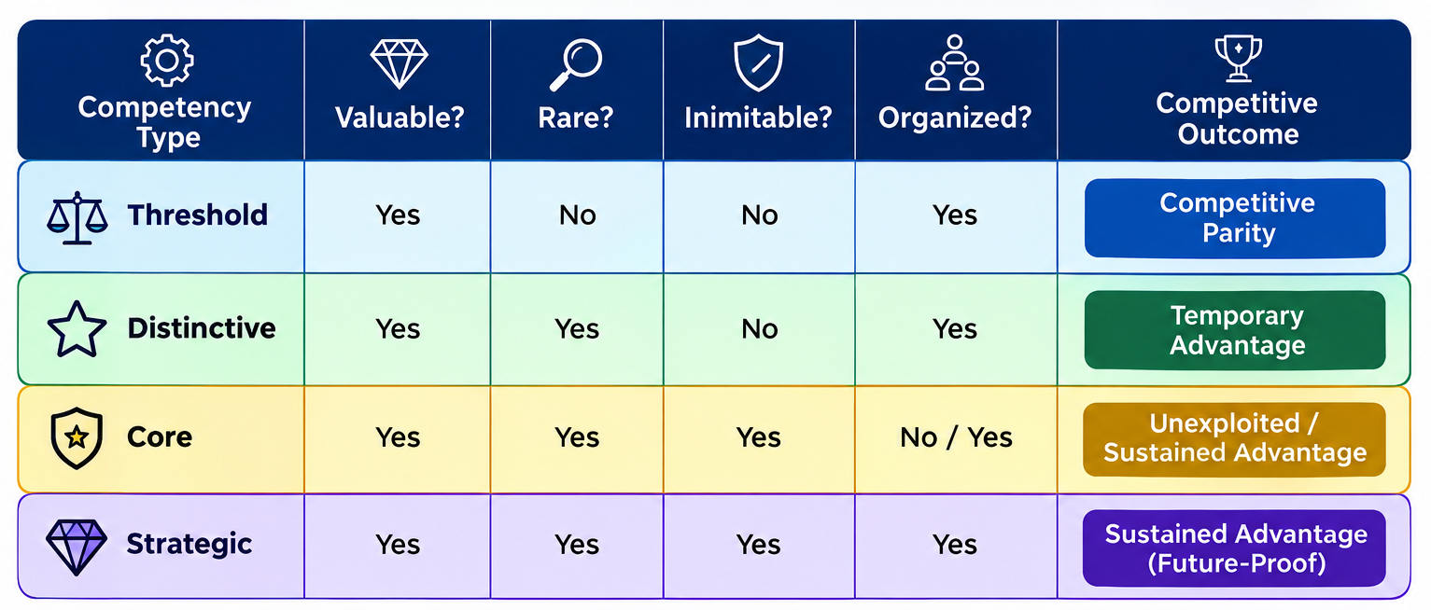
CLASS ACTIVITY · 10 MINUTES
Competency mapping through VRIO

Slide 20
WHY THIS MATTERS
Why You Must Know your Real Competence
1
Spending time and money polishing a threshold competence wastes resources better spent on a strategic one
2
Zerodha didn't win by matching every rival feature — it won on the one capability that was genuinely rare
3
Knowing your competence type tells you exactly what to protect, and what's safe to outsource
14 / 16

Slide 21
SUMMARY
Key Takeaways from Today
A competence is a skill or capability — not a resource you simply own
Threshold and core competencies are necessary but not unique; distinctive and strategic ones are rare
VRIO framework as a tool to identify and work on competencies
A strategic competence is rare AND drives why customers choose you
Zerodha won on one strategic competence — in-house technology — not on matching every rival feature

Slide 22
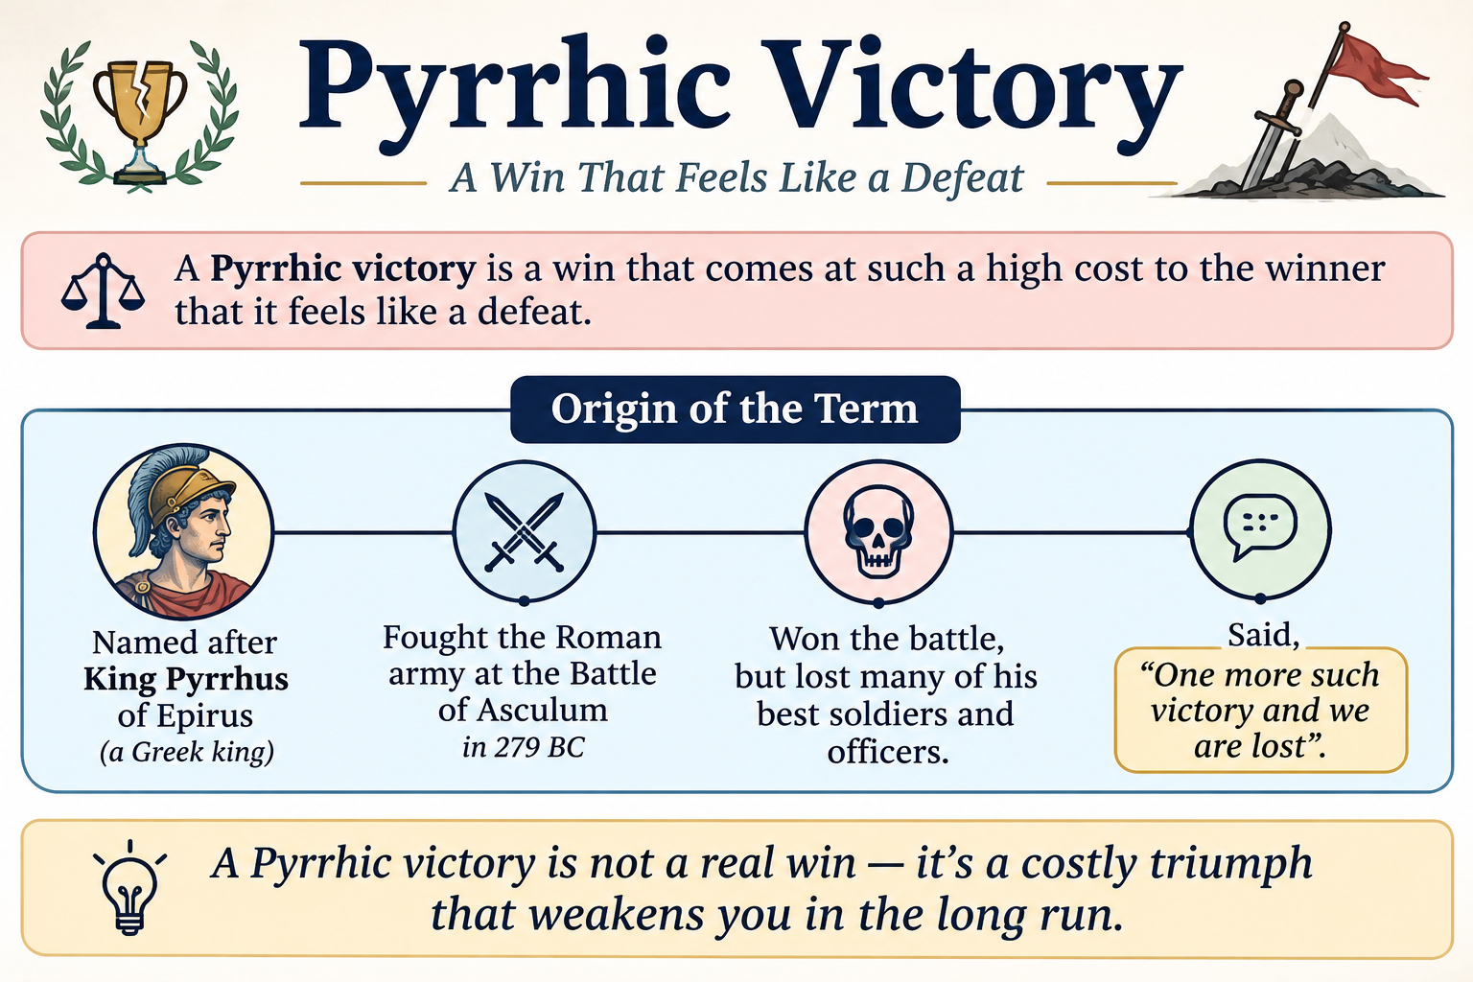
Term of the day
Pyrrhic Victory

Slide 23
REFERENCES & NEXT SESSION
Sources & What's Coming Up
Required Reading
A. Nag — Strategic Management: Analysis, Implementation and Control, Ch. 5, 7
Case & History Sources
Term for next session: Apostatic Selection
Publicly documented history of Zerodha (founded 2010)
16 / 16

